Slide 1


Paper ID- 1007 Binary Classification of Brain MRI Images for Detection of Brain Tumor using Convolutional Neural Network
Authors
Anika Bushra Chowdhury
Department of CSE, RUET
Emrana Kabir Hashi
Assistant Professor
Department of CSE, RUET
Presented by
Anika Bushra Chowdhury
Department of CSE, RUET

Slide 2
Outline:-
Introduction
Problem Statement
Related Works
Research Questions
Research Objectives
Methodology
Experimental Results
Conclusion & Future work
References

Slide 3
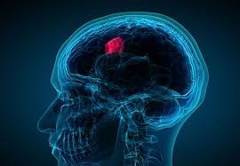
Introduction:-
Brain Tumor :-
Brain tumor can be defined as unnatural and uncontrolled growth in brain cells.[1]
Types of Brain Tumor :-
Glioma
Medulloblastoma
Lymphoma
Meningioma
Craniopharyngioma
Pituitary adenoma
Figure 1: Brain Tumor.

Slide 4
Problem Statement:-
The aim of this study is to evaluate the impact of both shallow and deep convolutional neural networks on a small dataset.
To perceive why different models show different level of accuracy on unseen test data.
Brain tumor has a higher mortality rate (18.8%) and low survival rate(less than five years) than other common type of cancer reported by New Philanthropy Capital (NPC).
Early detection can increase the survival rate.
Using MRI images because of it’s superior image quality and the fact of relying on no ionizing radiation.

Slide 5
Related Works:-
Predictive modeling of brain tumor: A Deep learning approach
PRIYANSH SAXENA, AKSHAT MAHESHWARI, SAUMIL MAHESHWARI, ABV-Indian Institute of Information Technology and Management, Gwalior, IN
SHIVANI TAYAL, Indian Statistical Institute, Delhi Centre, IN
Contributions :-
1. Used Brain MRI Images for Brain Tumor Detection dataset.
2. Applied transfer learning using three pre-trained models, which are VGG-16, Inception-V3, Resnet-50.
3. Achieved accuracy of 90% for VGG-16, 55% for Inception-V3 and 95% for Resnet-50.[2]

Slide 6
Related Works:-
Brain tumor classification in MRI image using convolutional neural network
Hassan Ali Khan1, Wu Jue1;, Muhammad Mushtaq2 and Muhammad Umer Mushtaq3;4
1 School of Computer Science and Technology, Southwest University of Science and Technology, Mianyang 621010, China // 2 Institute for Neuro and Bioinformatics, University of L¨ubeck, Germany // 3 School of Information Engineering, Southwest University of Science and Technology, Mianyang 621010, China // 4 Department of Software Engineering, MUST, Mirpur AJK, Pakistan
Contributions :-
1. Proposed CNN architecture with 8 convolution layers and 4 max pooling layers.
2. Applied transfer learning using three pre-trained models VGG-16, Inception-V3, Resnet-50.
3. Compared the proposed model with the pre-trained models .
4. Achieved accuracy of 96% for VGG-16, 75% for Inception-V3, 89% for Resnet-50 and 100% for the proposed model.[3]

Slide 7
Research Questions:-
How many layers should the model have for a dataset this size?
Do pre-trained models perform better?
How different measures of accuracy differ as the model deepens?

Slide 8
Objective:-
To tune a simple CNN architecture to observe how it works on a small dataset.
To classify brain tumor using simple CNN architecture and Pre-trained models.
Analysis the results and finding the most accurate one.
ANALYSIS
DATASET SELECTION
Brain MRI images for Brain Tumor Detection
COMPARISION
AUGMENTATION &
PRE-PROCESSING
GETTING RESULT
CLASSIFICATION

Slide 9
Methodology:-
Dataset: The title of the dataset used is Brain MRI Images for Brain Tumor Detection By Navoneel Chakrabraty[4]. It has 253 images in two folders named yes and no. The no folders has 98 images of benign non-cancerous tumors and the yes folder has 155 images of malignant cancer.
Data Pre-processing: For every image following steps are taken to pre-process,
1. Cropping the image containing only the brain part.
2. Resizing the image to have a shape of (224, 224, 3).
3. Applying normalization: to scale pixel values to the range 0-1.

Slide 10
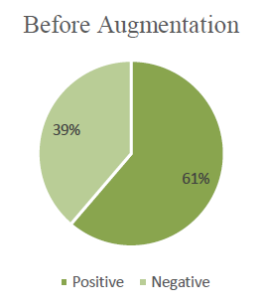
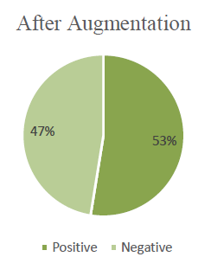
Methodology:-
Data Augmentation:
Data split: The data was split as 70% for training,15% for validation & 15% for testing which means 1445 images are for the training set, 310 images for the validation set and 310 images for the test set.

Slide 11
CNN Model:-
The basic CNN architecture goes as following:
Each input x (image) has a shape of (224, 224, 3) and is fed into the neural network.
A convolutional layer starts with 16 filters, with a filter size of (3,3) and a stride equal to 1.
The filter size gradually increases from 16 to 32 to 64 and finally 128.
A batch normalization layer to normalize pixel values to speed up computation.
A ReLU activation layer.
A Max Pooling layer with f=2 and s=2.
A flatten layer in order to flatten the 3-dimensional matrix into a one-dimensional vector.
A Dense (output unit) fully connected layer with one neuron with a sigmoid activation (since this is a binary classification task).

Slide 12
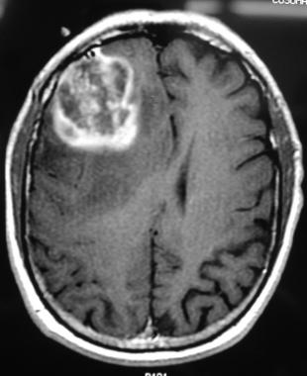
CNN Model:-
Input Image
Conv Layer
Conv Layer
Conv Layer
Max Pooling
Max Pooling
16
32
64
111,111,16
109,109,32
54,54,32
222,222,16
52,52,64
224,224,3
Conv Layer
Conv Layer
FC
FC
Max Pooling
Max Pooling
Output
128
128
26,26,64
24,24,128
22,22,128
11,11,128
Yes/No
3872
7744

Slide 13
Experimental Results:-
Table 1: Performance of different CNN models.
Convolutional/Pooling layer | Train Accuracy | Validation Accuracy | Test Accuracy | Precision | Recall | F1 Score
1/1 | 100 | 83.55 | 81.22 | 81.57 | 80.51 | 81.04
2/2 | 100 | 84.52 | 87.09 | 88.16 | 88.69 | 88.42
3/3 | 100 | 84.84 | 87.70 | 87.20 | 90.36 | 88.75
4/4 | 100 | 92.90 | 92.26 | 91.77 | 92.95 | 92.35
5/4 | 99.93 | 93.23 | 95.79 | 95.40 | 97.08 | 96.23
6/4 | 100 | 90.00 | 91.29 | 93.33 | 89.17 | 91.21
7/4 | 54.32 | 53.87 | 52.90 | 52.90 | 100 | 69.19
8/4 | 57.11 | 47.10 | 49.68 | 49.68 | 100 | 66.38

Slide 14
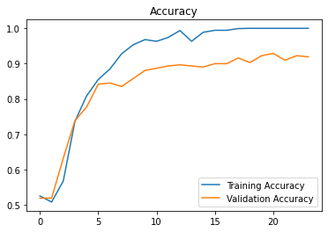
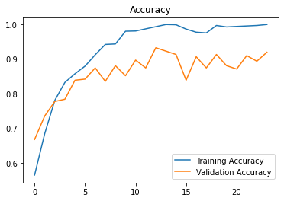
(a) Model trained with 4 convolutional layers (b) Model trained with 5 convolutional layers
Figure 2. Accuracy graph of some of the models with highest test accuracy(%).

Slide 15
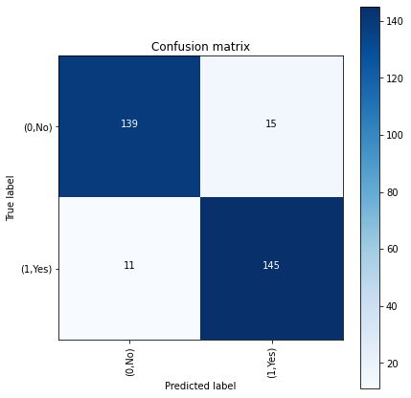
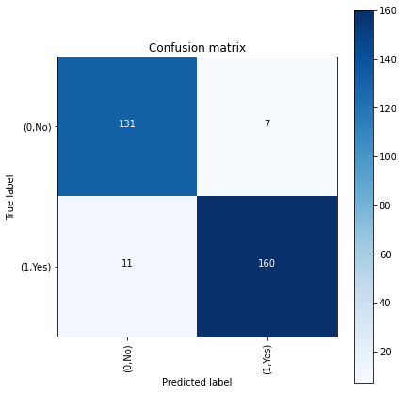
(a) Model trained with 4 convolutional layers (b) Model trained with 5 convolutional layers
Figure 3. Confusion matrix of some of the models with highest test accuracy(%).

Slide 16
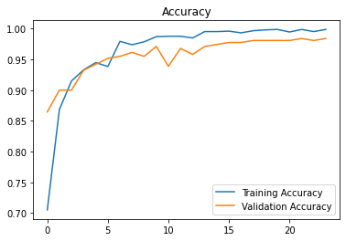
VGG-16:-
VGG-16: It is a deep learning model which is made available alongside pre-trained weights. It has 23 layers in total.[5]
Input size: (224, 224, 3) which is channels first.
Pre-processing function: tf.keras.applications.vgg16.preprocess_input().
Parameters: Total 14,739,777 among them 25,089 are trainable and 14,714,688 are non-trainable.
Figure 4: Accuracy graph for VGG-16.

Slide 17
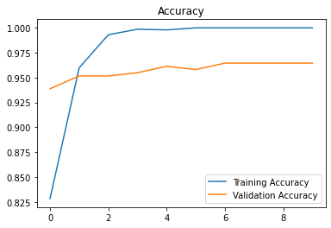
InceptionV3:-
InceptionV3: It is a deep learning model which is made available alongside pre-trained weights. It has 159 layers in total.[6]
Input size: (299, 299, 3) which is channels first.
Pre-processing function: tf.keras.applications.InceptionV3.preprocess_input().
Parameters: 21,933,857 among them 131,073 are trainable and 21,802,784 are non-trainable.
Figure 5: Accuracy graph for InceptionV3.

Slide 18
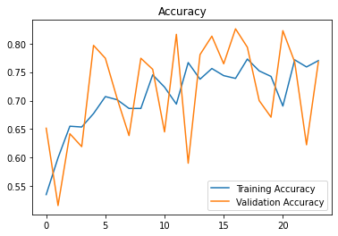
ResNet50 :-
ResNet50: The basic building block of ResNet is residual blocks, meaning each layer feeds into the next also into the layers which are 2-3 jumps ahead of it. It has 50 layers hence the name ResNet50.[7]
Input size: (224, 224, 3) which is channels first.
Pre-processing function: tf.keras.applications.resnet.preprocess_input().
Parameters: Total 23,688,065 among them 100,353 are trainable and 23,587,712 are non-trainable.
Figure 6: Accuracy graph for ResNet50.

Slide 19

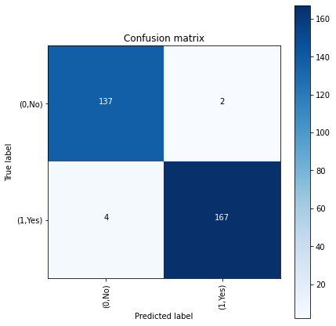
(a) Pre-trained model VGG-16 (b) Pre-trained model InceptionV3
Figure 7. Confusion matrix of some of the models with highest test accuracy(%).

Slide 20
Experimental Results:-
Table 2: Accuracy of pre-trained CNN models.
CNN Architecture | Train Accuracy | Validation Accuracy | Test Accuracy | Precision | Recall | F1 Score
VGG16 | 99.86 | 98.39 | 98.71 | 99.36 | 98.10 | 98.73
InceptionV3 | 99.72 | 96.45 | 98.06 | 98.82 | 97.66 | 98.23
ResNet50 | 72.81 | 82.58 | 81.29 | 76.64 | 87.07 | 81.53

Slide 21
Comparison:- Table 3: Comparison of accuracy between this research and work previous related.
 | Proposed Model | VGG16 | InceptionV3 | ResNet50
Hassan Ali Khan et al.[3] | 100% | 96% | 75% | 89%
Priyansh Saxena et al.[2] | N/A | 90% | 55% | 95%
This thesis | 94.52% | 97.42% | 97.09% | 81.29%

Slide 22
Conclusion & Future Work:-
The basic architecture can be tuned with a bigger dataset to decrease over-fitting.
Cross validation can be used to split the dataset.
The filter size and number can be tweaked to observe how it affects the accuracy curve.
The dataset can be trained with other pre-trained models such as AlexNet, GoogleNet etc.
Some models showed a lot of over-fitting and steps can be taken to reduce it.

Slide 23
References:-
[1] H. H. Sultan, N. M. Salem, and W. Al-Atabany, “Multi-Classification of Brain Tumor Images Using Deep Neural Network,” IEEE Access, vol. 7, pp. 69215–69225, 2019, doi: 10.1109/ACCESS.2019.2919122.
[2] P. Saxena, A. Maheshwari, and S. Maheshwari, “Predictive Modeling of Brain Tumor: A Deep Learning Approach,” in Advances in Intelligent Systems and Computing, 2021, vol. 1189, pp. 275–285, doi: 10.1007/978-981-15-6067-5_30.
[3] H. A. Khan, W. Jue, M. Mushtaq, and M. U. Mushtaq, “Brain tumor classification in MRI image using convolutional neural network,” aimspress.com, doi: 10.3934/mbe.2020328.
[4] “Brain MRI Images for Brain Tumor Detection | Kaggle.” [Online]. Available: https://www.kaggle.com/navoneel/brain-mri-images-for-brain-tumor-detection.
[5] “VGG16 and VGG19.” [Online]. Available: https://keras.io/api/applications/vgg/#vgg16-function.
[6] “InceptionV3.” [Online]. Available: https://keras.io/api/applications/inceptionv3.
[7] “ResNet and ResNetV2.” [Online]. Available: https://keras.io/api/applications/resnet/#resnet50-function.

Slide 24
Thank You.

